Slide 1



GRADUATION PROJECT 1
SMART AUTOMATED GATE
WEBSITE & Real Model

Slide 2

01
Introduction
"Smart Automated Gate" is a gate similar to a university gate, but it opens and closes automatically as soon as a car from the cars authorized to enter arrives through a camera that captures the car’s number and searches for it in the database. If this number exists, it will be given. He ordered the gate to open, and if he was not there, no order was given to the gate to open, and university security will be directed to this car.
Smart automated gate

Slide 3
PROJECT AIM
02
The aim of the project is to design and implement a Smart Portal Access Control System capable of accurately determining the authorization status of vehicles based on their license plate numbers. The system will provide seamless 11 and efficient vehicle access management while enhancing security and user experience.
Smart automated gate

Slide 4
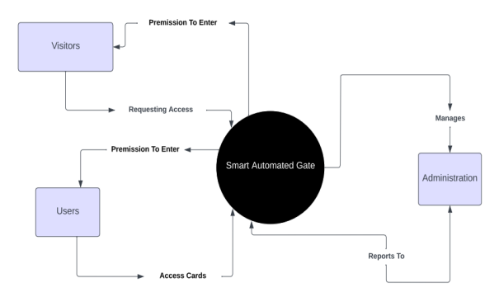
Context Diagram
Scope Of The Project
03
Smart automated gate

Slide 5
04
Related existing systems
Here we show you some examples of a model of a smart automatic gate that operates remotely..
Smart automated gate

Slide 6
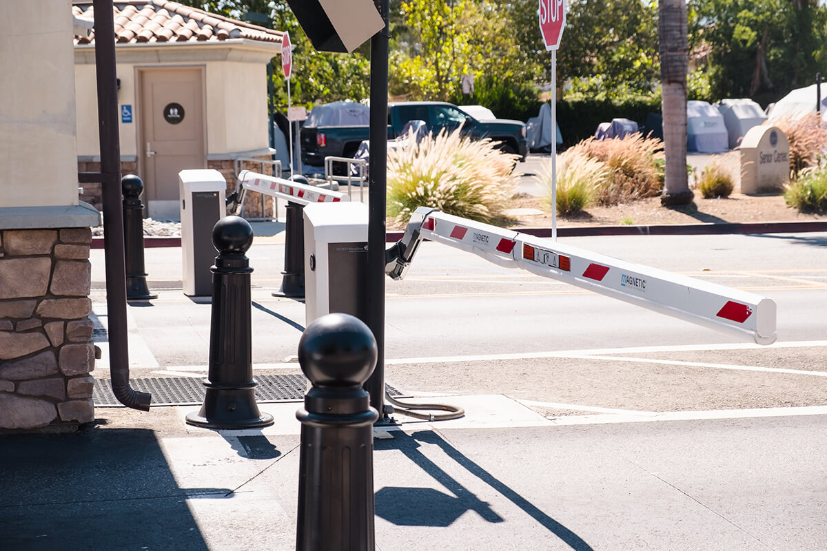
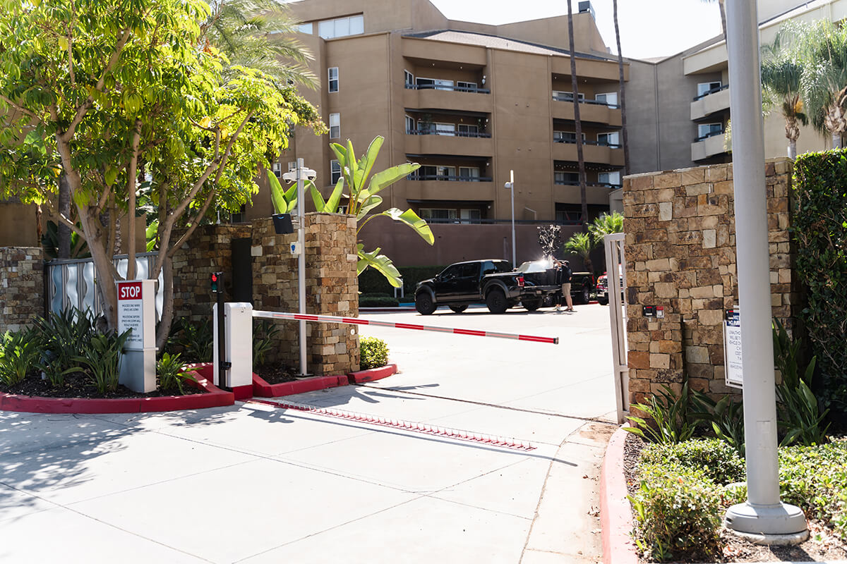
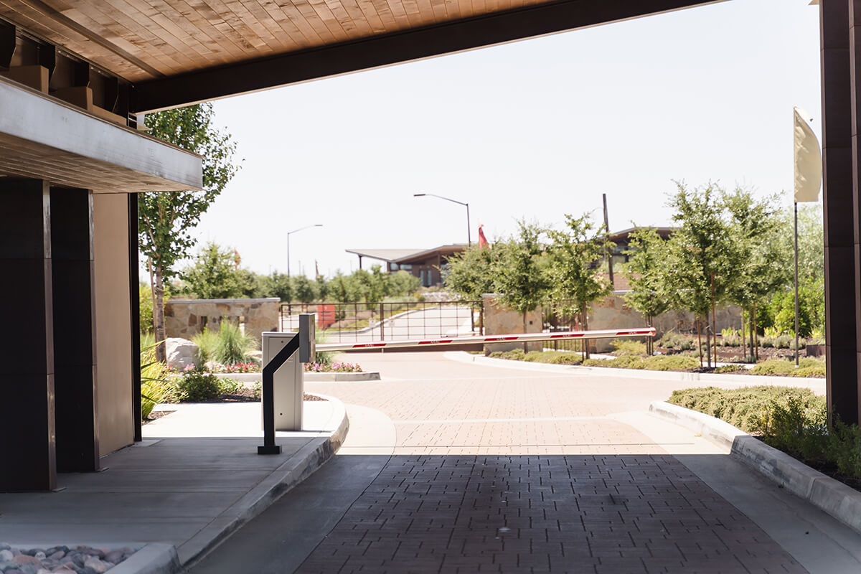
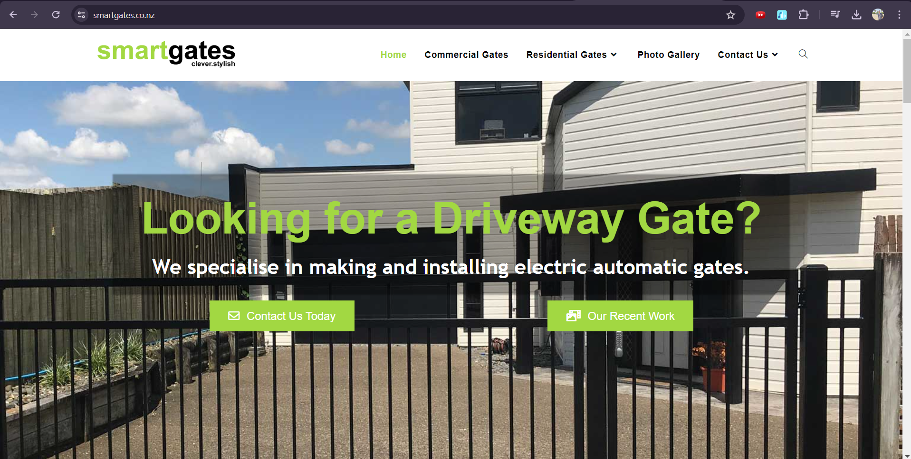
01.
02.
03.
05
Smart automated gate

Slide 7
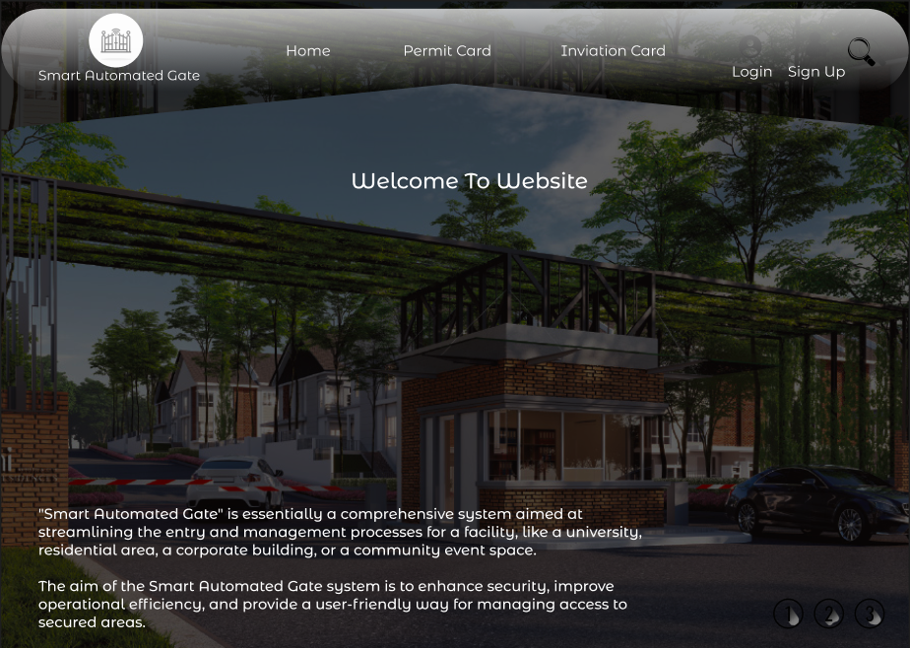
Smart Automated Gate
"Here we presenting our website that embodies the concept of the smart automated gate. Let us now begin with the detailed explanation..."
06
Smart automated gate

Slide 8


Smart automated gate
FUNCTIONAL REQUAIRMENT
Software
Engineering | 2024

Slide 9
FUNCTIONAL REQUAIRMENT
Functional Requirement & Modelling:
The system shall allow users to create an account using their email address and password.
The system shall provide a mechanism for users to request invitation cards for specific dates and times.
The system shall allow users to cancel or modify their existing bookings up to a certain time before the scheduled visit.
The system shall send an email confirmation to users once their booking is successful or if there is a change in their booking status.
07

Slide 10
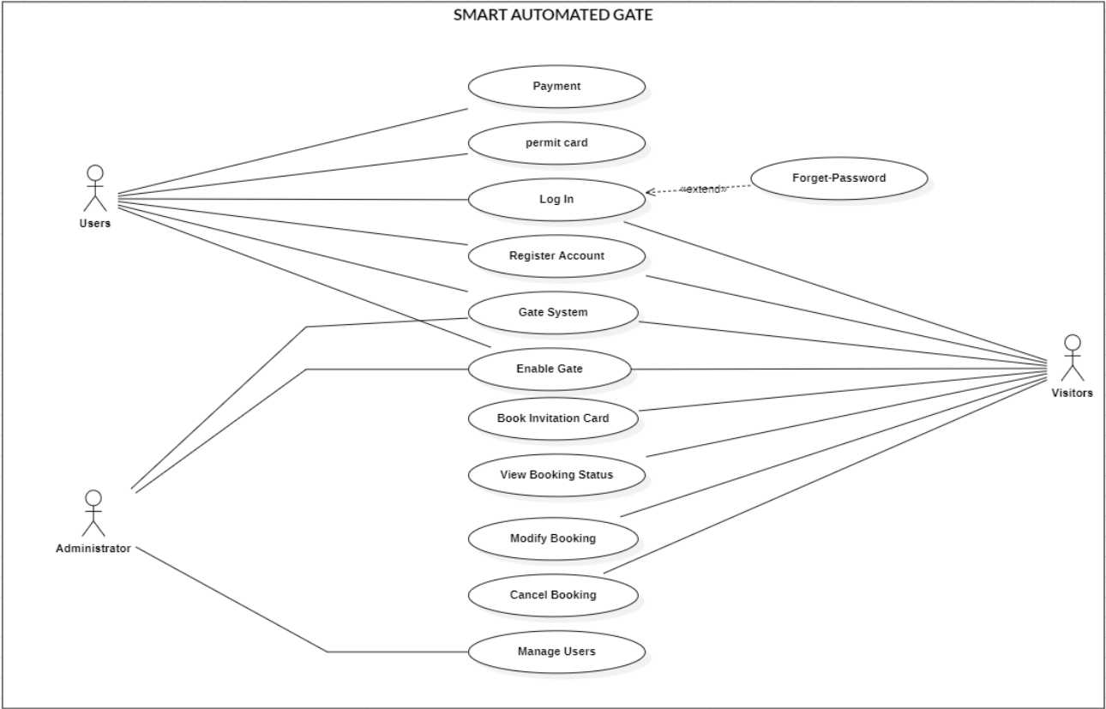
08
USE CASE
our use case contains three main actors: Users, Admin, and the Visitors. It also contains every main action for each of them.

Slide 11
Smart automated gate
NONFUNCTIONAL
Requirements
Software
Engineering | 2024

Slide 12
09
Nonfunctional
Requirements
Availability
Reliability
Security
Usability
Maintainability
Performance
Smart automated gate

Slide 13
Smart automated gate
PROTOTYPING
AND UI
Software
Engineering | 2024

Slide 14
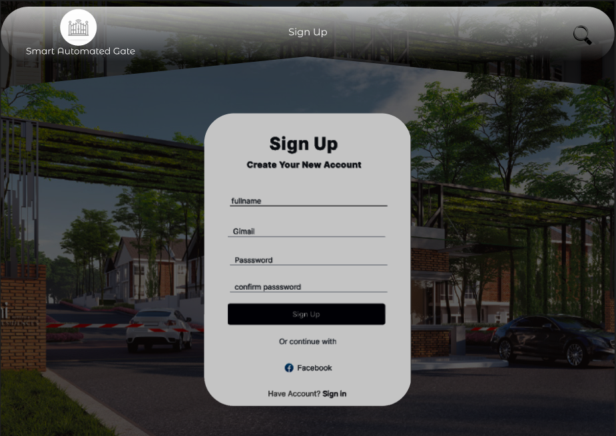
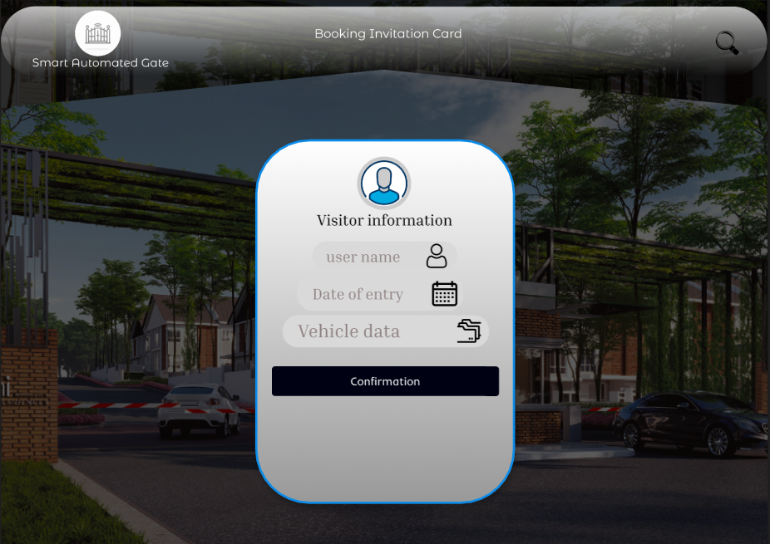
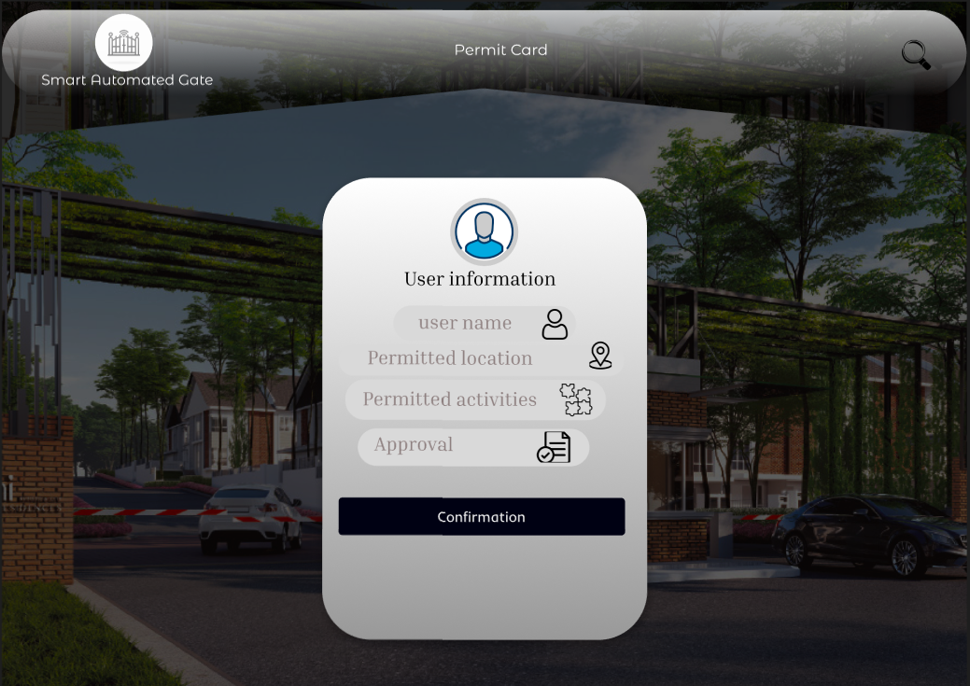
10
Now we will Take you a tour in our website..
Easy to Use
Modern Design
Attracts attention
User Friendly
Smart automated gate

Slide 15
Smart automated gate
SOFTWARE ARCHITECTURE
Software
Engineering | 2024

Slide 16
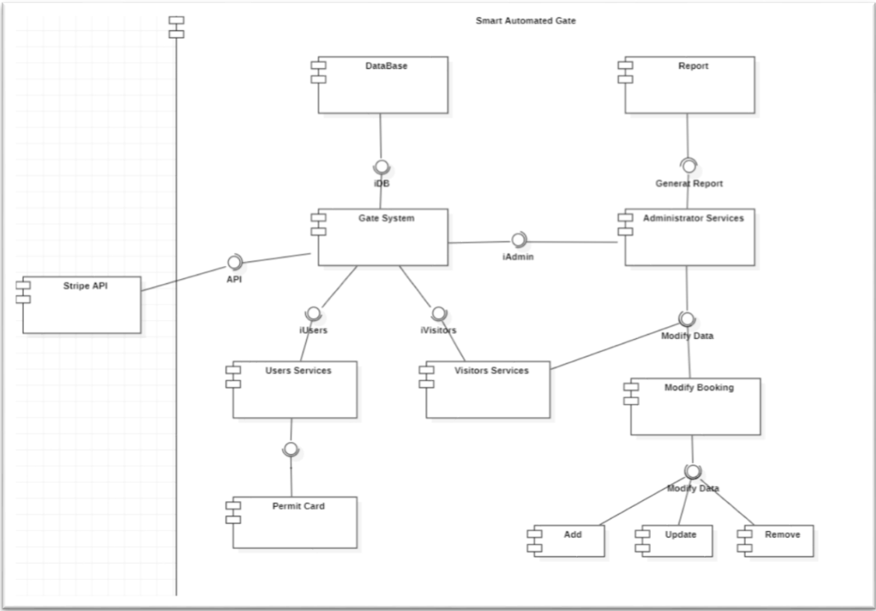
SOFTWARE ARCHITECTURE
11
Smart automated gate

Slide 17
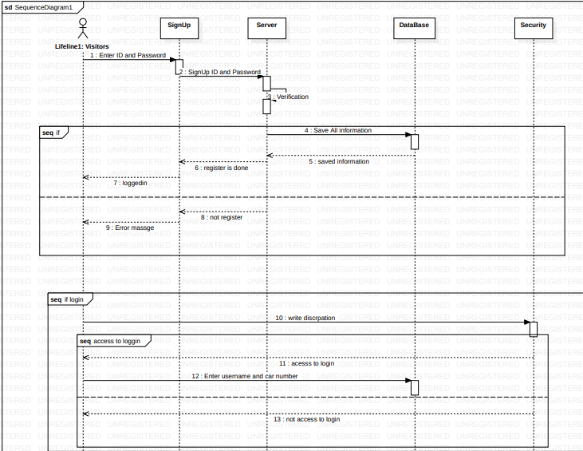
We are presenting some of the Internal
Interactions
12
Sign Up
Smart automated gate

Slide 18
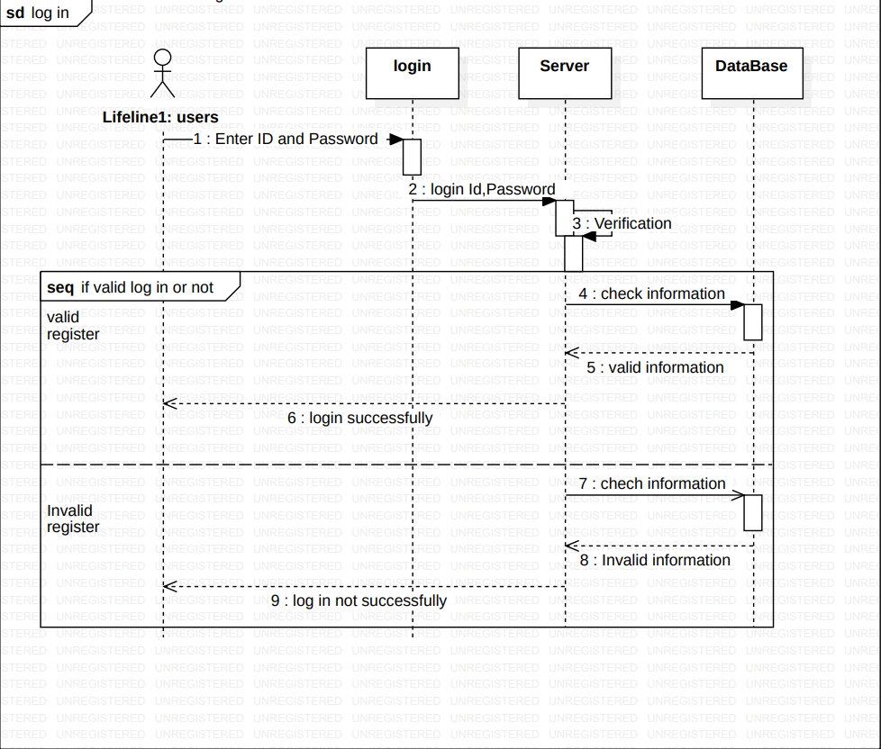
We are presenting some of the Internal
Interactions
13
Log in
Smart automated gate

Slide 19
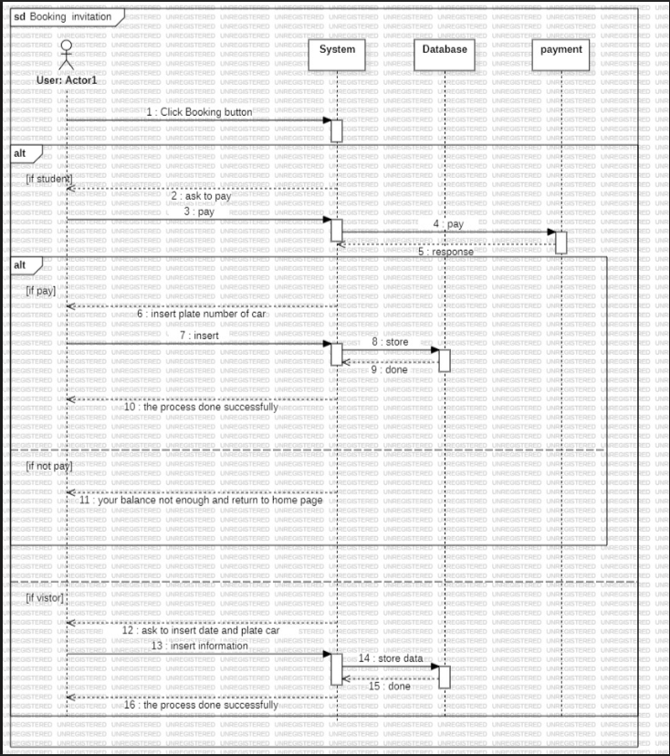
We are presenting some of the Internal
Interactions
14
Booking Invitation
Smart automated gate

Slide 20
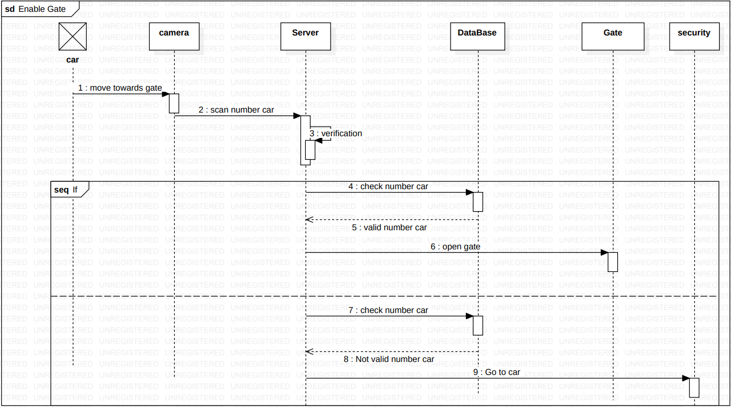
We are presenting some of the Internal
Interactions
15
Enable Gate
Smart automated gate

Slide 21
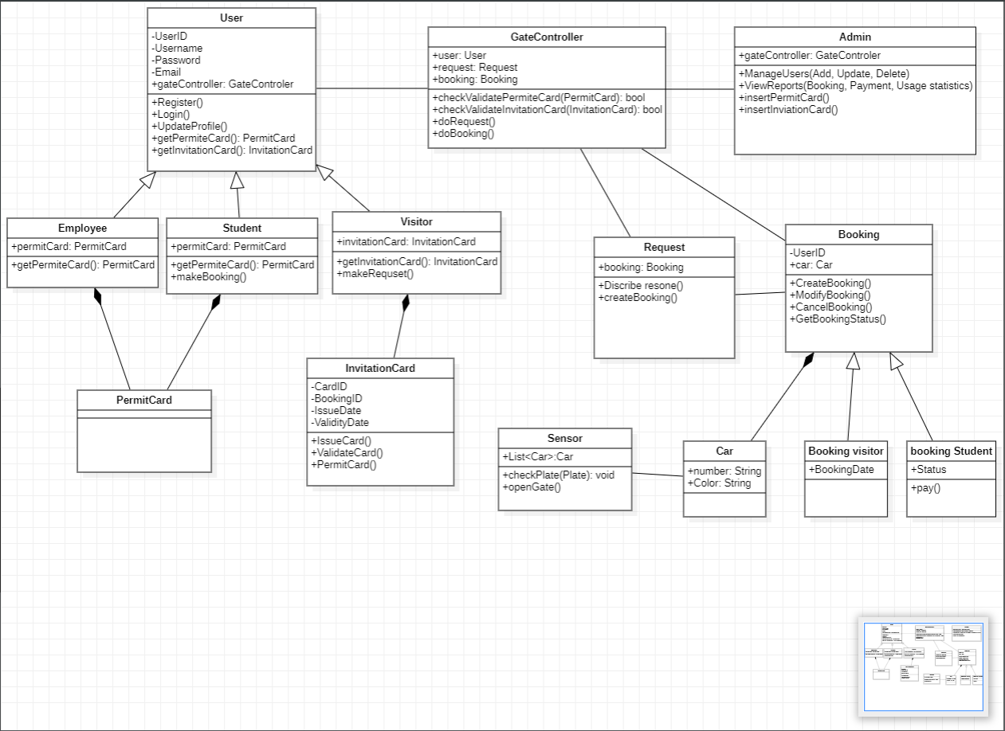
Let’s take a look on class diagram
16
Smart automated gate

Slide 22
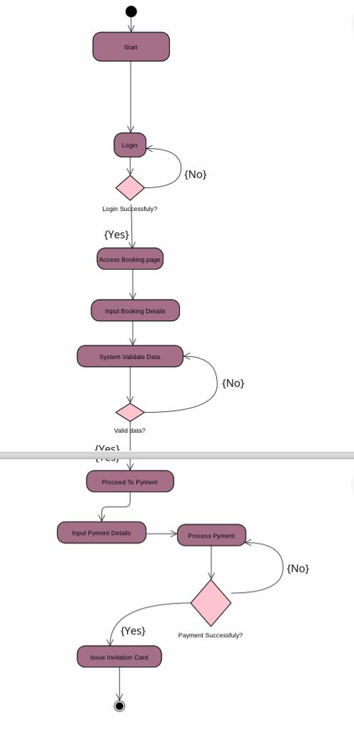
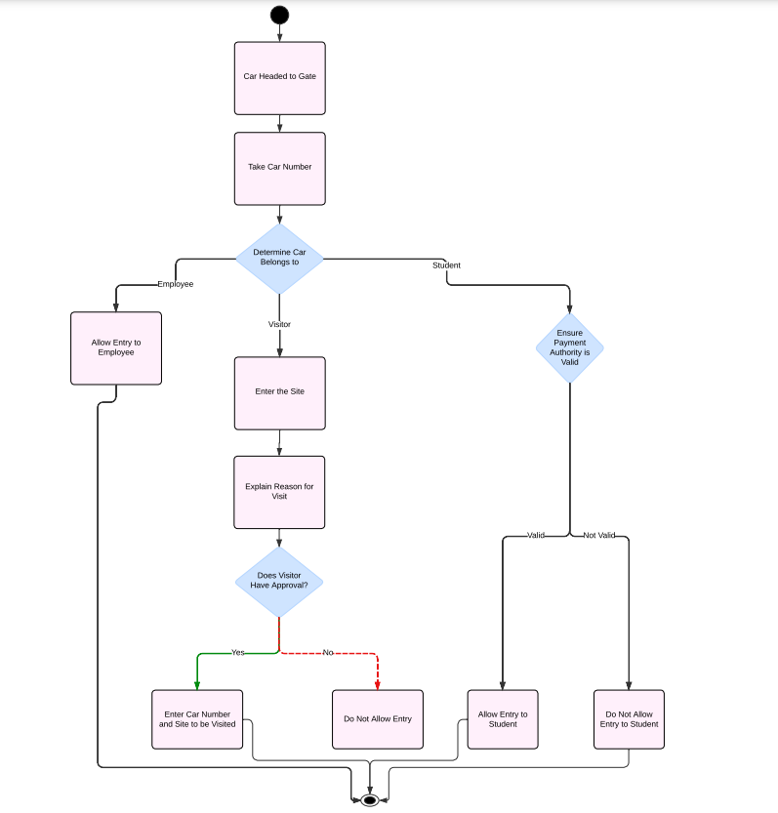
Activity Diagram
17
“Here is a simple diagram illustrating the main states that the application can enter.”
Smart automated gate

Slide 23
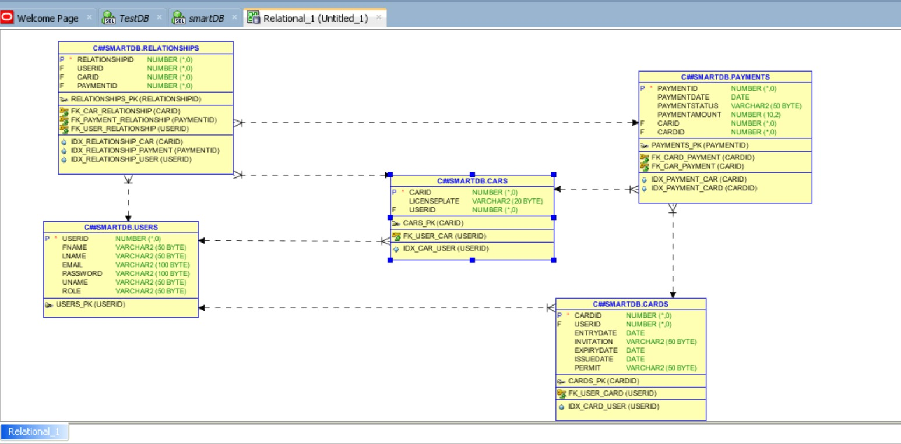
Data Storage Organization
18
Smart automated gate

Slide 24
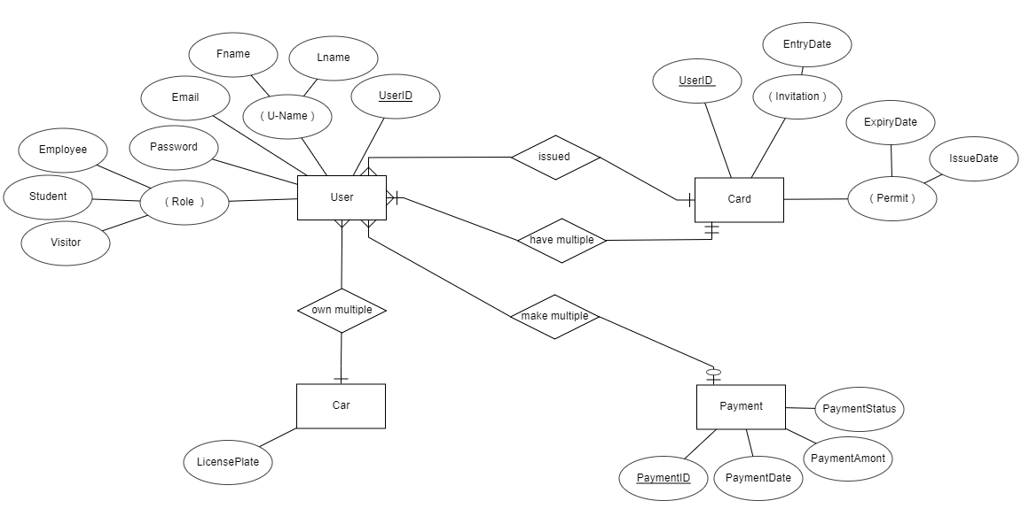
ER Diagram
"Here is a ER diagram illustrating the main states that the website can enter.."
19
Smart automated gate

Slide 25
Smart automated gate
TESTING AND
TESTING PLAN
Software
Engineering | 2024

Slide 26

20
Tools
Widget testing
Integration testing
Unit testing
End to End testing
using
Code coverage tools
Using mock objects
For code coverage we will use flutter command flutter test –coverage or a tool called CODECOV
Mockito is a framework that will be used to test using mock objects
Smart automated gate

Slide 27
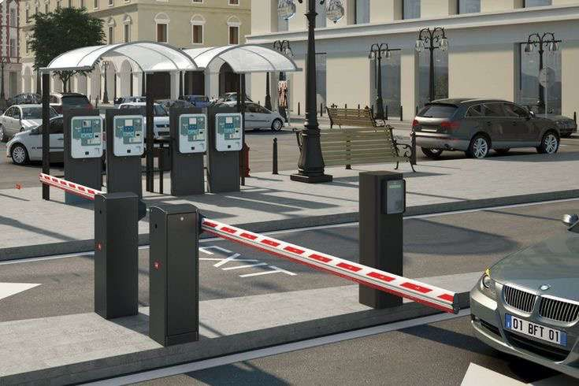
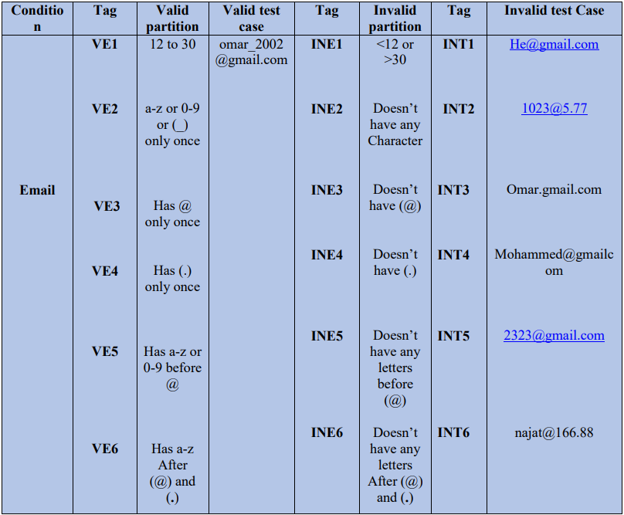
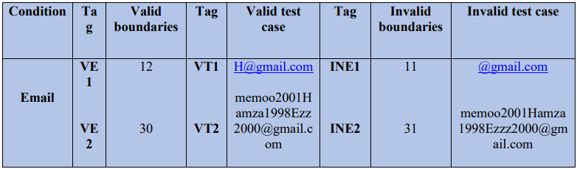
Our Testing Plan
Equivalence partitioning (Email).
21
Boundary Value analysis (Email).
Smart automated gate

Slide 28
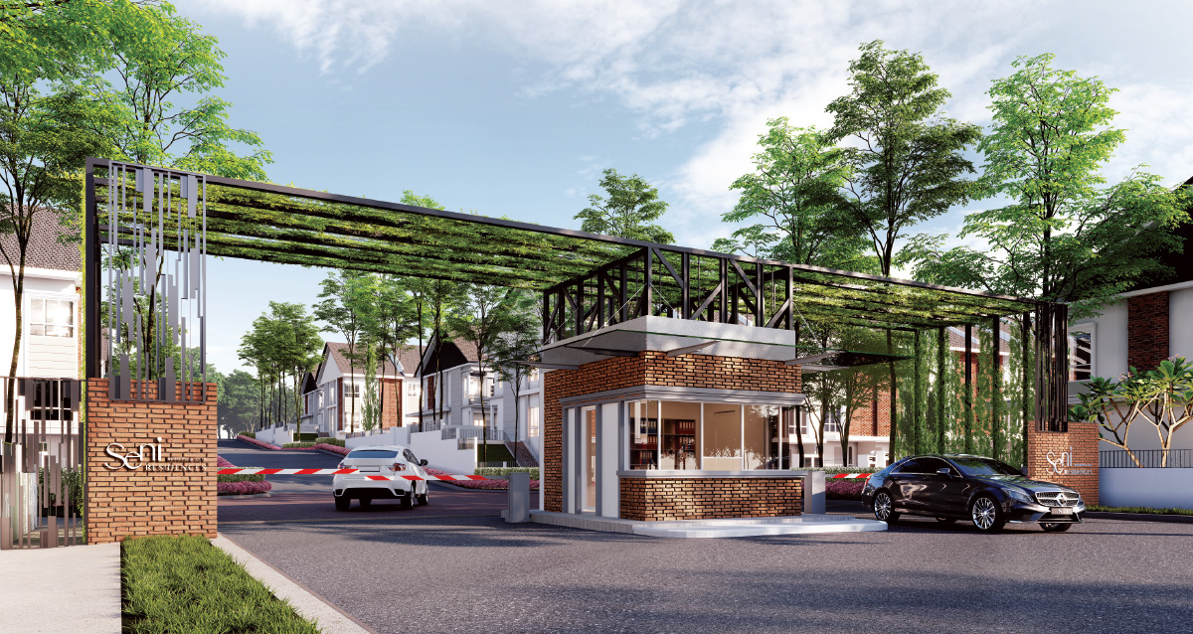
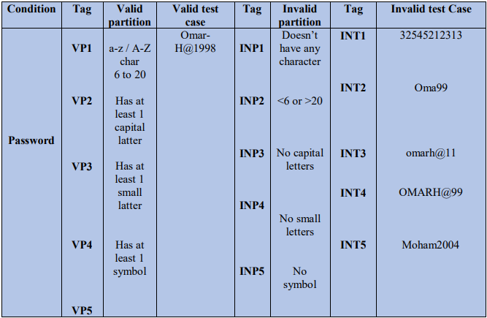
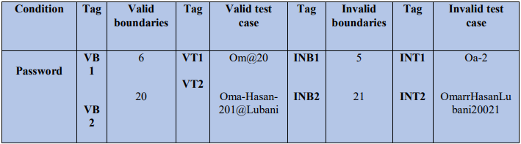
Our Testing Plan
Equivalence partitioning (Password)
22
Boundary Value analysis (Password).
Smart automated gate

Slide 29
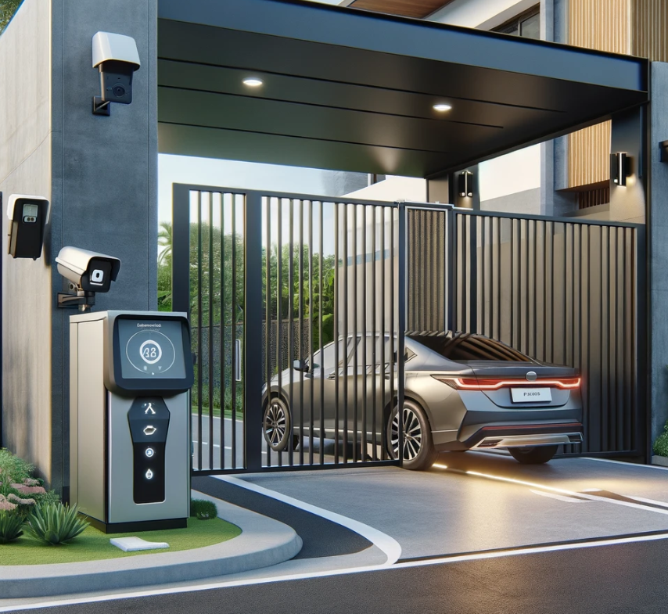
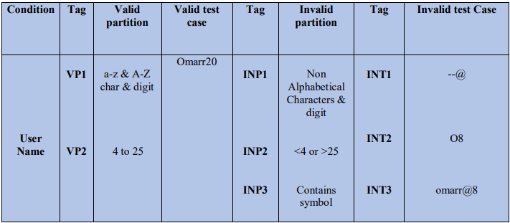
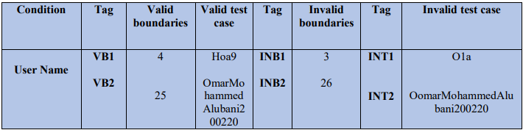
Our Testing Plan
Equivalence partitioning (Username).
23
Boundary Value analysis (username)
Smart automated gate

Slide 30
Smart automated gate
THE END
Software
Engineering | 2024

Slide 31


Thank You
For your time

